Slide 1
Structures

Slide 2
Structures
Structure is a collection of variables that can be of the same or different data types.
The data items in a structure are called the members of the structure.
A user can define its own data types using structures.
A structure in C/C++ is like a record of other languages

Slide 3
A structure type in C++ is called struct.
A struct is heterogeneous in that it can be composed of data of different types.
In contrast, array is homogeneous since it can contain only data of the same type.

Slide 4
Advantages of Structures
It clarifies the code by showing that the data defined in the structure are intimately related.
It simplifies passing the data to functions. Instead of passing multiple variables separately, they can be passed as a single unit.

Slide 5
Examples of Structures
  Student record: student id, name, major, gender, start year, …
  Bank account: account number, name, currency, balance, …
  Address book: name, address, telephone number, …

Slide 6
Structures
Individual components of a struct type are called members (or fields).
Members can be of different types (simple, array or struct).
A struct is named as a whole while individual members are named using field identifiers.
Complex data structures can be formed by defining arrays of structs.

Slide 7
struct basics
Definition of a structure:
struct <struct-type>{
<type> <identifier_list>;
<type> <identifier_list>;
...
} ;
Example:
struct Date {
int day;
int month;
int year;
} ;
Each identifier
defines a member
of the structure.
The “Date” structure
has 3 members,
day, month & year.

Slide 8
struct examples
Example:
struct StudentInfo{
int Id;
int age;
char Gender;
double CGA;
};
Example:
struct StudentGrade{
char Name[15];
char Course[9];
int Lab[5];
int Homework[3];
int Exam[2];
};
The “StudentInfo”
structure has 4 members
of different types.
The “StudentGrade”
structure has 5
members of
different array types.

Slide 9
struct examples
Example:
struct BankAccount{
char Name[15];
int AcountNo[10];
double balance;
Date Birthday;
};
Example:
struct StudentRecord{
char Name[15];
int Id;
char Dept[5];
char Gender;
};
The “BankAcount”
structure has simple,
array and structure
types as members.
The “StudentRecord”
structure has 4
members.

Slide 10
struct basics
Declaration of a variable of struct type:
<struct-type> <identifier_list>;
Example:
StudentRecord Student1, Student2;
Student1 and Student2 are variables of StudentRecord type.
Name
Id Gender
Dept
Name
Id Gender
Dept
Student1
Student2

Slide 11
Structures
#include<iostream.h>
#include<conio.h>
struct Part
{
int mn;
int pn;
float cost;
};
void main(void)
{ clrscr();
  Part p1;
  p1.mn=6244;
  p1.pn=373;
  p1.cost=217.5;
  cout<<"Model Number "<<p1.mn<<endl;
  cout<<"Part Number "<<p1.pn<<endl;
  cout<<"Cost is Rs. "<<p1.cost<<endl;
  getch();
}
Output
Model Number 6244
Part Number 373
Cost is Rs. 217.5

Slide 12
Structures
Defining Structure Variables
  A structure variable is defined the same way as a variable of any built-in data type i.e.
  int age; // age is a variable of built-in data type Integer
  part p1; //p1 is a variable of structure type part

Slide 13
Structures
Accessing Structure Members
  The members of a structure variable are accessed by a dot operator, i.e.
  p1.mn = 6244;
  p1.pn = 373;

Slide 14
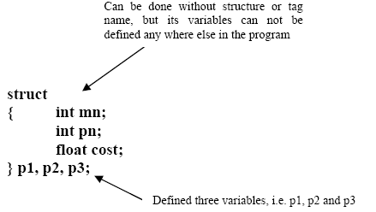
Structures
Combining Structure Specifier and Definition
  Structure specifer and defining structure variables can be combined into a single statement, i.e.

Slide 15
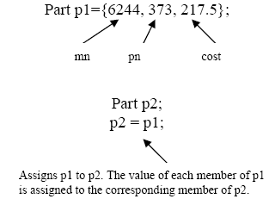
Structures
Initializing Structure Members
  Structure members can be initialized when a structure variable is declared just as variables can be initialized when it is defined, i.e. int a=13;
  Similarly,

Slide 16
Structures
#include<iostream.h>
#include<conio.h>
struct Distance
{ int feet;
float inches;
};
void main(void)
{ clrscr();
  Distance d1, d2, d3;
  cout<<"Enter feet for 1st Distance ";
  cin>>d1.feet;
  cout<<"Enter inches for 1st Distance ";
  cin>>d1.inches;
  cout<<"Enter feet for 2nd Distance ";
  cin>>d2.feet;
  cout<<"Enter inches for 2nd Distance ";
  cin>>d2.inches;
  d3.inches = d1.inches + d2.inches;
  d3.feet = 0;
  if(d3.inches >= 12.0)
  { d3.inches -= 12.0;
    d3.feet++;
  }
  d3.feet += d1.feet+ d2.feet;
  cout<<"Total Distance is "<<d3.feet<<"\'-"<<d3.inches<<"\"";
getch();
}

Slide 17
Structures within Structures
#include<iostream.h>
#include<conio.h>
struct Distance
{ int feet;
float inches;
};
struct Room
{ Distance length;
Distance width;
};
void main(void)
{ clrscr();
  Room dining;
  dining.length.feet = 13;
  dining.length.inches = 6.5;
  dining.width.feet = 10;
  dining.width.inches = 5.0;
  float length = dining.length.feet + dining.length.inches / 12;
  float width = dining.width.feet + dining.width.inches / 12;
  cout<<"Dining Room Area is "<< length*width <<" Square Feet";
  getch();
}

Slide 18

Initializing Nested Structures

Slide 19
Enumerated Data Types
Structures can be looked as a way of providing user-defined data types. Another way of defining our own data types is enumerated data type.
Enumerated data type is used when a user knows before a list of values that a data type can use.

Slide 20
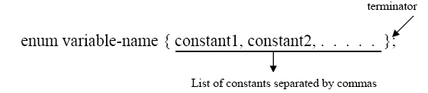
Enumerated Data Types

Slide 21
Enumerated Data Types
#include <iostream.h>
#include <conio.h>
enum dow{friday, saturday, sunday, monday, tuesday, wednesday, thursday};
void main(void)
{
clrscr();
  dow d1, d2;
  d1 = monday;
  d2 = thursday;
  int difference = d2 - d1;
  cout<<"Day between Monday through Thursday are "<<difference<<endl;
  if(d1<d2)
  cout<<"Monday comes before Thursday";
getch();
}
Output
Day between Monday through Thursday are 3
Monday comes before Thursday

Slide 22
Enumerated Data Types
In enum, every possible value should have a name, i.e. saturday, sunday etc
Variable of enumerated data type, i.e. d1 and d2 can be given any of the value listed in the enum specifier.
A value that is not listed in enum specifier can not be assigned to an enum variable.
Arithmetic operators can be used with enum types, i.e. +, -, / etc
Enumerated data types are treated internally as integers. Normally the first name in the list is given value 0, 1 to second and so on.

Slide 23
Specifying Integer Values
In enum specifier first member name gets a value 0, second gets 1 and so on. But the order can be changed, i.e. instead of starting from 0, if user wants to start from 5, then 6 and so on, then it can be done the following way.
enum dow{friday=5, saturday, sunday, monday, tuesday, wednesday, thursday};

